Slide 1
Find the clique of maximum length in given graph.
By Ajay Pilania (IRM2014007)
Shubham Swarnkar (IWM2014001)
Ashok Maloth (IIM2014006)

Slide 2
Introduction
For a given graph, a clique is subgraph which is complete. Our objective is to find the clique of maximum length.

Slide 3


Algorithms
There are two algorithms to find maximum length clique.
Brute Force Approach Using simple brute force approach
Bron–Kerbosch Algorithm Using the standard Bron-Kerbosch Algorithm

Slide 4
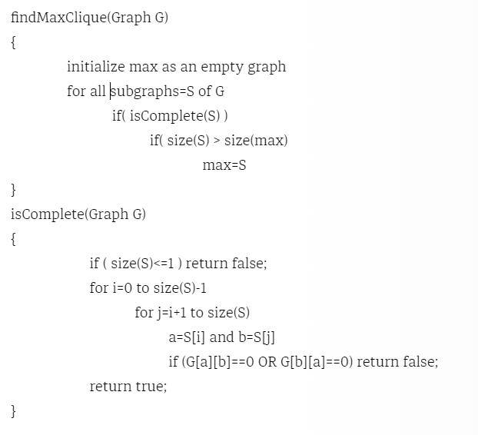
Brute Force Approach

Slide 5
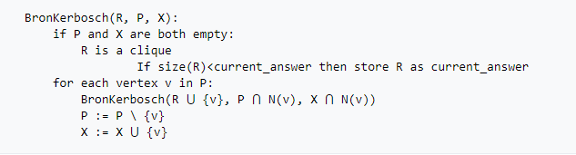
Bron–Kerbosch Algorithm

Slide 6
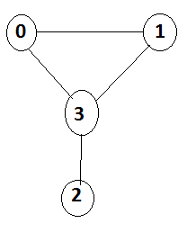
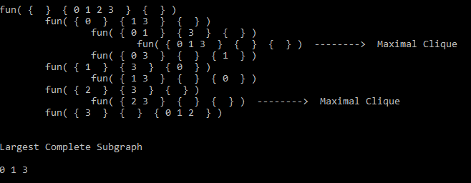
Recursive calls for the Given graphs are as follows -:

Slide 7
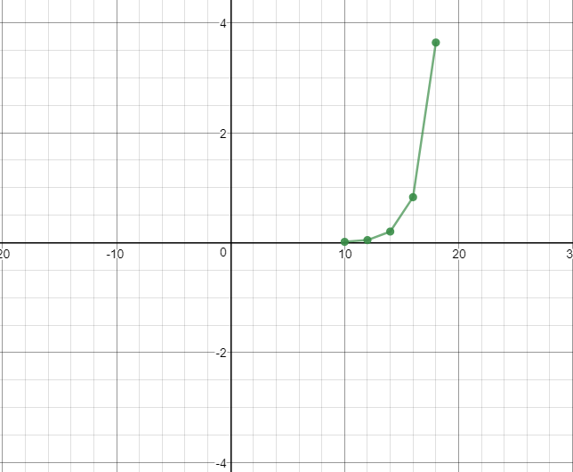
Time Complexity for Brute-force approach
Time Complexity : O(2^{n}*N²)

Slide 8
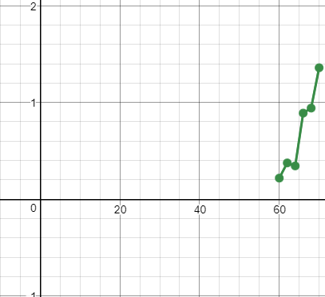
Time Complexity for Bron-Kerbosch Algorithm
Time Complexity : O(N^{k}) if k is the size of maximum lenght complete subgraph

Slide 9

Thank you.

